Slide 1

Kevin Bembridge
University of the District of Columbia Master’s Program (Statistics)

Slide 2
Background
The increase in population after World War II (WWII)
What is gross domestic product (GDP) and its importance.
The variables are Year; Population; GDP; GDP growth rate; Population growth rate; change in population; change in GDP

Slide 3
Terminology
Pop- population
Gdp – gross domestic product
Chanpop – change in population
Changdp – change in GDP
Gdpgr – GDP growth rate
Popgr – population growth rate
Pcgr –per capita GDP growth rate

Slide 4
Growth rate= (current year – previous year) / (previous year)
Change in data= current year – previous year

Slide 5
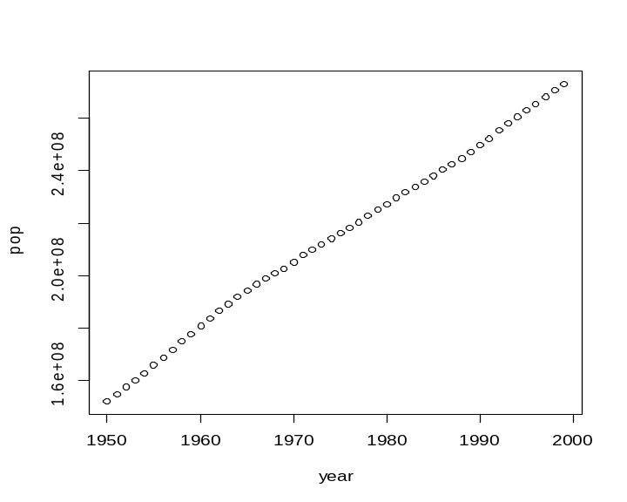
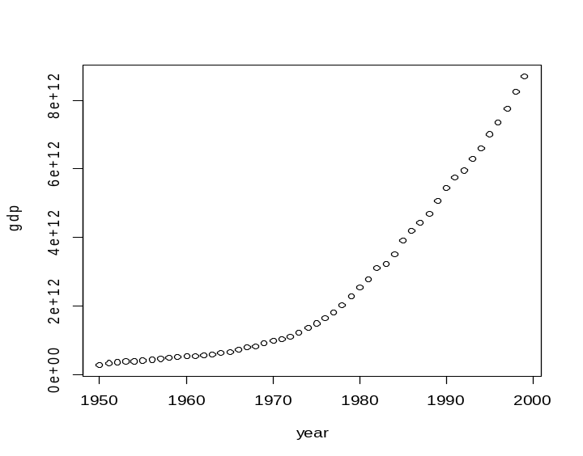
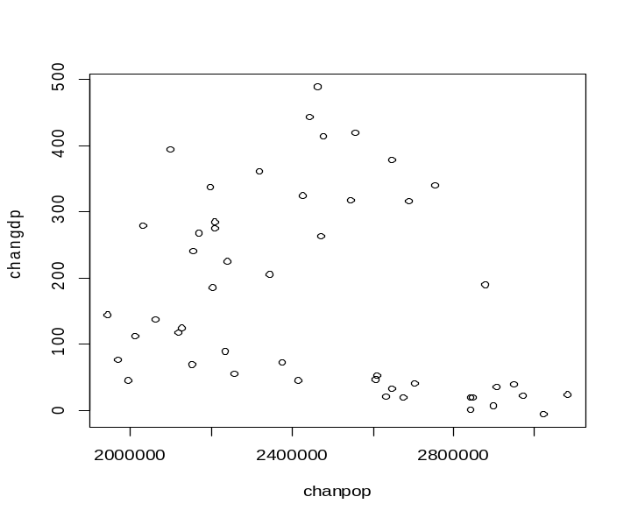
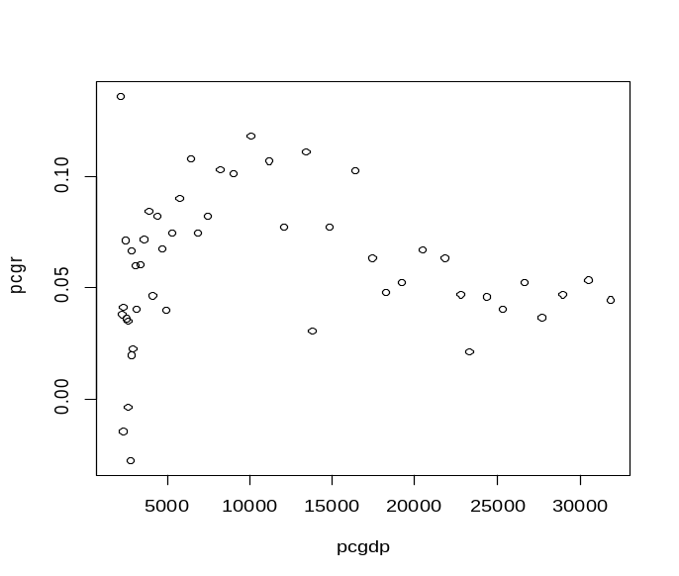
Data and Methodology

Slide 6
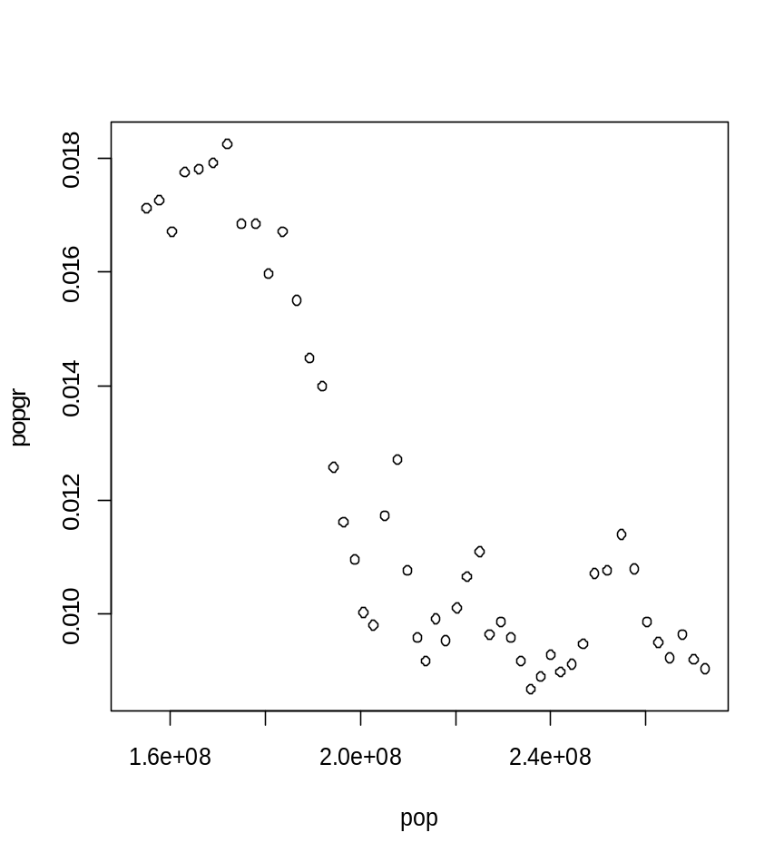
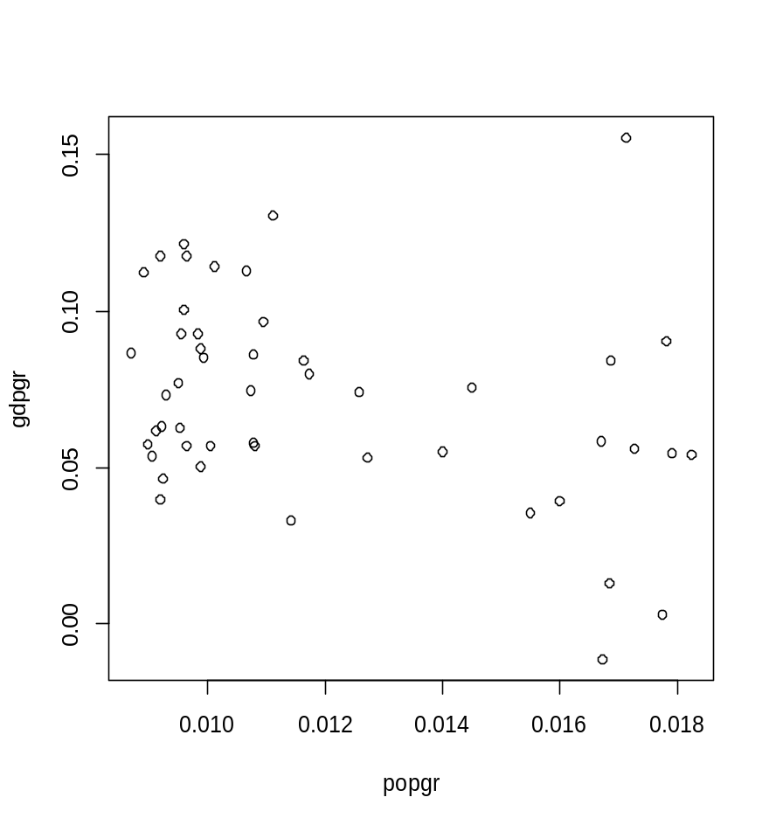
Focus data for this paper

Slide 7
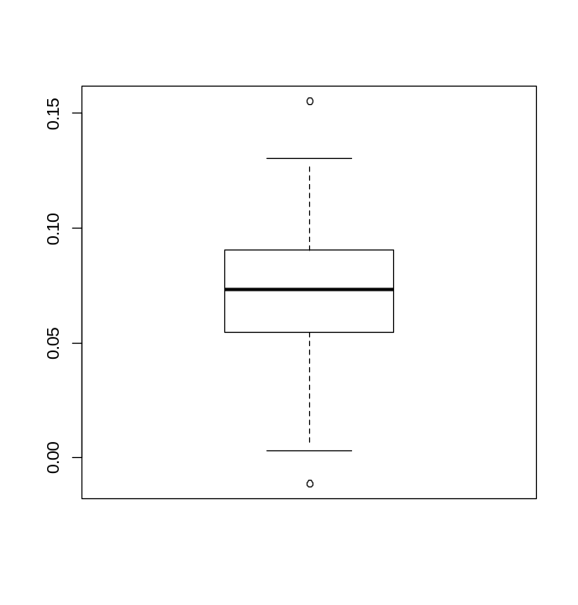
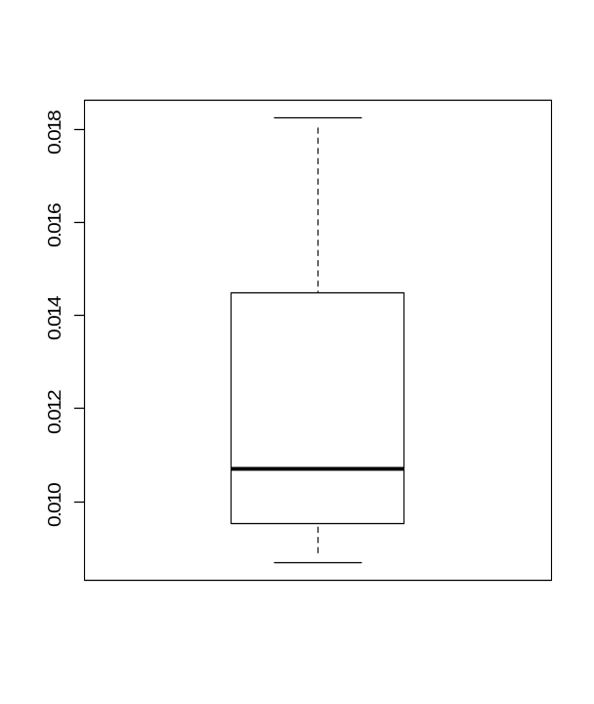
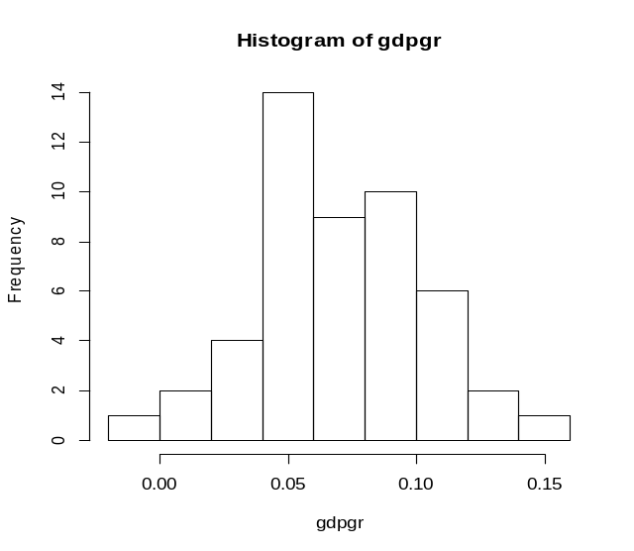
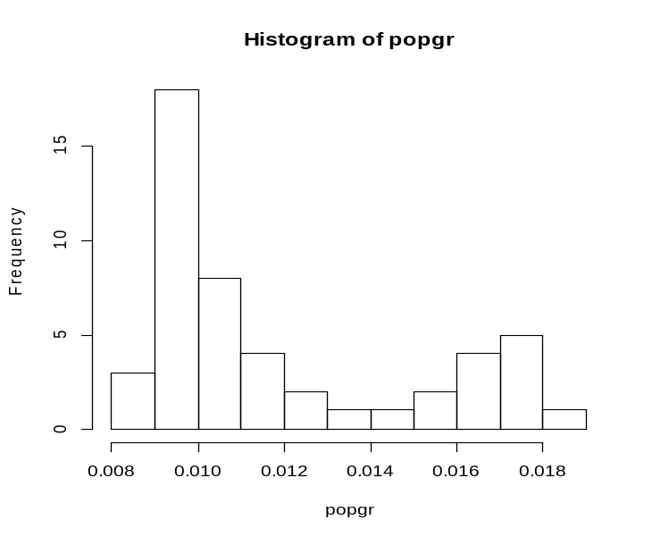
Graphs

Slide 8
summary(popgr) population growth rate
Min. 0.008695 1st Qu. 0.009547 Median 0.010720 Mean 0.011970 3rd Qu. 0.014500 Max. 0.018240 NA’s 1
summary(pop) population
Min. 152300000 1st Qu. 187200000 Median 214900000 Mean 214100000 3rd Qu. 241700000 Max. 272700000
summary(gdpgr) GDP growth rate
Min. -0.01115 1st Qu. 0.05474 Median 0.07300 Mean 0.07207 3rd Qu. 0.09017 Max. 0.15530 NA's 1

Slide 9
Comparing GDP growth rate with population growth rate.
While Population growth rate and population do not have any outliers. GDP growth rate has 2 outliers.
0.01115122 and 0.15526047
Using Resistant Line from three group with slope and central value
yhat= intercept + slope (data –median of data)
Slope = (right.Y-left.Y)/(right.X-left.X)
Intercept = 1/3{[left.Y – slope( left.X – med.X)] + med.Y + [right.Y – slope( right.X – med.X)]}
Residual = given data – yhat
Page 133, Understanding Robust and Exploratory Data Analysis

Slide 10
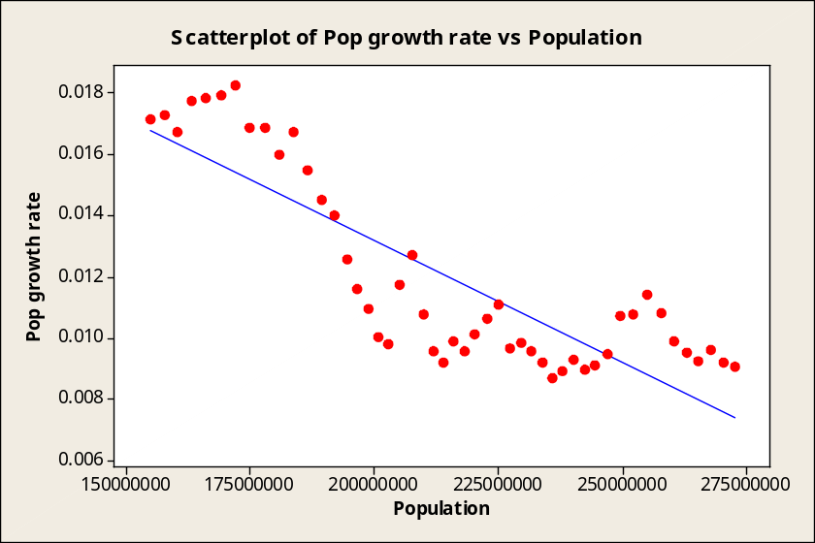
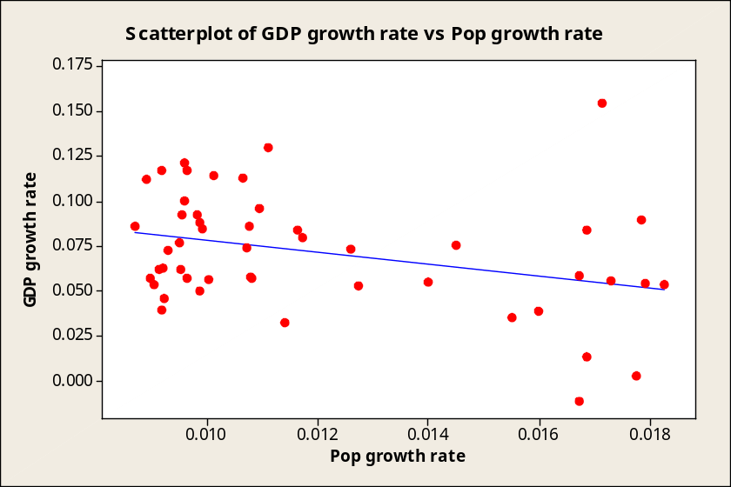
The regression equation is
Pop growth rate = 0.0291 - 1.014636e-10 Population
The regression equation is
GDP growth rate = 0.112 - 3.37 Pop growth rate

Slide 11
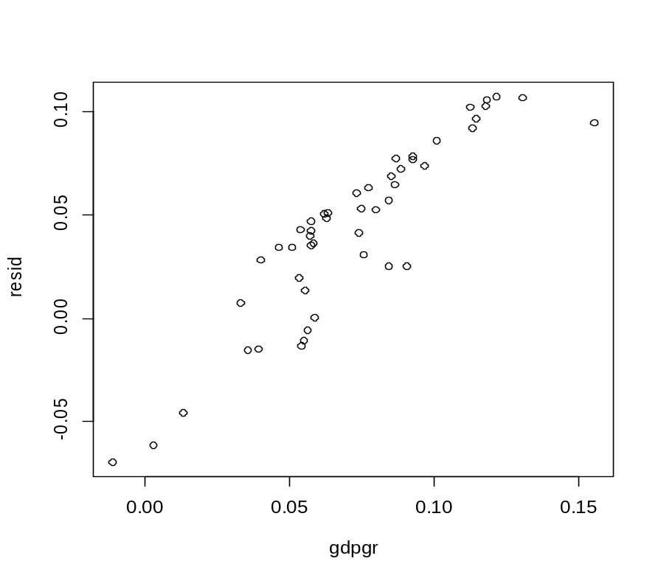
Finding the residual for the GDP growth rate, the above formula is used and we graph it against GDP growth rate.

Slide 12
Conclusion
Increase in population has a negative effect on population growth rate. The population growth deceasing but not by a huge margin.
A increase in population growth rate is a decrease in GDP growth rate.
A increase in the GDP growth rate indicate a increase in residuals (error)

Slide 13
Reference
R (version 2.15.2) [Software]
Minitab (version 14) [Software]
Microsoft Excel 97-2003
Hoaglin, Mosteller and Tukey (2000). Understanding Robust and Exploratory Data Analysis. Location:Canada.
http://www.bls.gov/
Shryocks, Henry (Journal of American Statistical Association Vol. 46, No. 256, Dec., 1951, pg 417-437) Redistribution of Population: 1940 to 1950

